Slide 1
Firm-Level Political Risk: Measurement and Effects
Tarek A Hassan, Stephan Hollander, Laurence van Lent, Ahmed Tahoun. The Quarterly Journal of Economics: November 2019, Vol. 134, Issue 4, pp. 2135-2202.
19. 12. 5.
Dongwoo Lee

Slide 2
Contents
1. Introduction (Main Topic + Literature Review)
2. Hypothesis Development → Main Findings
3. Sample and (Main) Variables
4. Research Design and Results
5. Conclusion

Slide 3




1. Introduction

Slide 4




1. INTRODUCTION ▶ Main Topic
Introduction
Main Findings
Sample and Variables
Res. Design and Results
Conclusion
Political Risk
60
60
60
Tarek A Hassan, Stephan Hollander, Laurence van Lent, Ahmed Tahoun. The Quarterly Journal of Economics: November 2019, Vol. 134, Issue 4, pp. 2135-2202.

Slide 5
1. INTRODUCTION ▶ Main Topic
Introduction
Main Findings
Sample and Variables
Res. Design and Results
Conclusion
Political Risk
100
20
60
① Firm-level data on exposure to political risks ▼
② Political issues ▼
Tarek A Hassan, Stephan Hollander, Laurence van Lent, Ahmed Tahoun. The Quarterly Journal of Economics: November 2019, Vol. 134, Issue 4, pp. 2135-2202.

Slide 6

1. INTRODUCTION ▶ Main Topic
Introduction
Main Findings
Sample and Variables
Res. Design and Results
Conclusion
Construct a new measure for firm-level political risk by using:
“ Simple pattern-based sequence classification method”
Tarek A Hassan, Stephan Hollander, Laurence van Lent, Ahmed Tahoun. The Quarterly Journal of Economics: November 2019, Vol. 134, Issue 4, pp. 2135-2202.

Slide 7

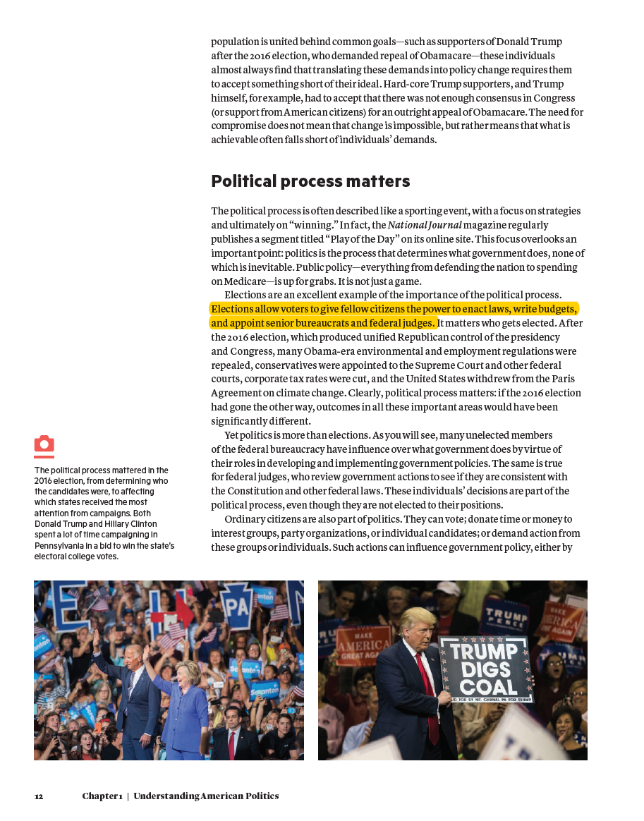
1. INTRODUCTION ▶ Main Topic
Introduction
Main Findings
Sample and Variables
Res. Design and Results
Conclusion
American Politics Today (2013) : initial political library
elections allow
allow voters
the power
federal judges
“Elections allow voters to give fellow citizens the power to enact laws, write budgets, and appoint senior bureaucrats and federal judges.”
Bianco,William T., and David T. Canon,
American Politics Today (Third Essentials Edition, 2013)
Tarek A Hassan, Stephan Hollander, Laurence van Lent, Ahmed Tahoun. The Quarterly Journal of Economics: November 2019, Vol. 134, Issue 4, pp. 2135-2202.

Slide 8

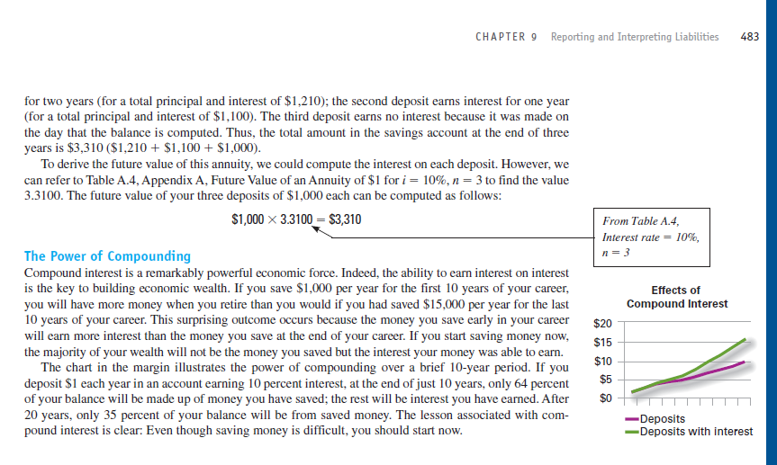
1. INTRODUCTION ▶ Main Topic
Introduction
Main Findings
Sample and Variables
Res. Design and Results
Conclusion
American Politics Today (2013) : initial political library
elections allow
allow voters
the power
federal judges
Financial Accounting (2011) : non-political library
the power
power of
have earned
start now
Libby, Robert, Patricia A. Libby, and Daniel G. Short,
Financial Accounting (Seventh Edition, 2011)
Tarek A Hassan, Stephan Hollander, Laurence van Lent, Ahmed Tahoun. The Quarterly Journal of Economics: November 2019, Vol. 134, Issue 4, pp. 2135-2202.

Slide 9
1. INTRODUCTION ▶ Main Topic
Introduction
Main Findings
Sample and Variables
Res. Design and Results
Conclusion
American Politics Today (2013) : initial political library
elections allow
allow voters
the power
federal judges
Financial Accounting (2011) : non-political library
the power
power of
have earned
start now
101,165 bigrams: political library
Tarek A Hassan, Stephan Hollander, Laurence van Lent, Ahmed Tahoun. The Quarterly Journal of Economics: November 2019, Vol. 134, Issue 4, pp. 2135-2202.

Slide 10
1. INTRODUCTION ▶ Main Topic
Introduction
Main Findings
Sample and Variables
Res. Design and Results
Conclusion
American Politics Today (2013) : initial political library
elections allow
allow voters
the power
federal judges
Financial Accounting (2011) : non-political library
the power
power of
have earned
start now
101,165 bigrams: political library
Construct a new measure for firm-level political risk by using:
“ Simple pattern-based sequence classification method”
Tarek A Hassan, Stephan Hollander, Laurence van Lent, Ahmed Tahoun. The Quarterly Journal of Economics: November 2019, Vol. 134, Issue 4, pp. 2135-2202.

Slide 11


1. INTRODUCTION ▶ Literature Review
Introduction
Main Findings
Sample and Variables
Res. Design and Results
Conclusion
“We adapt a simple pattern-based sequence classification method developed in computational linguistics” : Song and Wu 2008; Manning, Raghavan, and Schütze 2008
pattern-based: Use bigrams and their frequencies
sequence classification method:
associated with
"political risks"
Tarek A Hassan, Stephan Hollander, Laurence van Lent, Ahmed Tahoun. The Quarterly Journal of Economics: November 2019, Vol. 134, Issue 4, pp. 2135-2202.

Slide 12
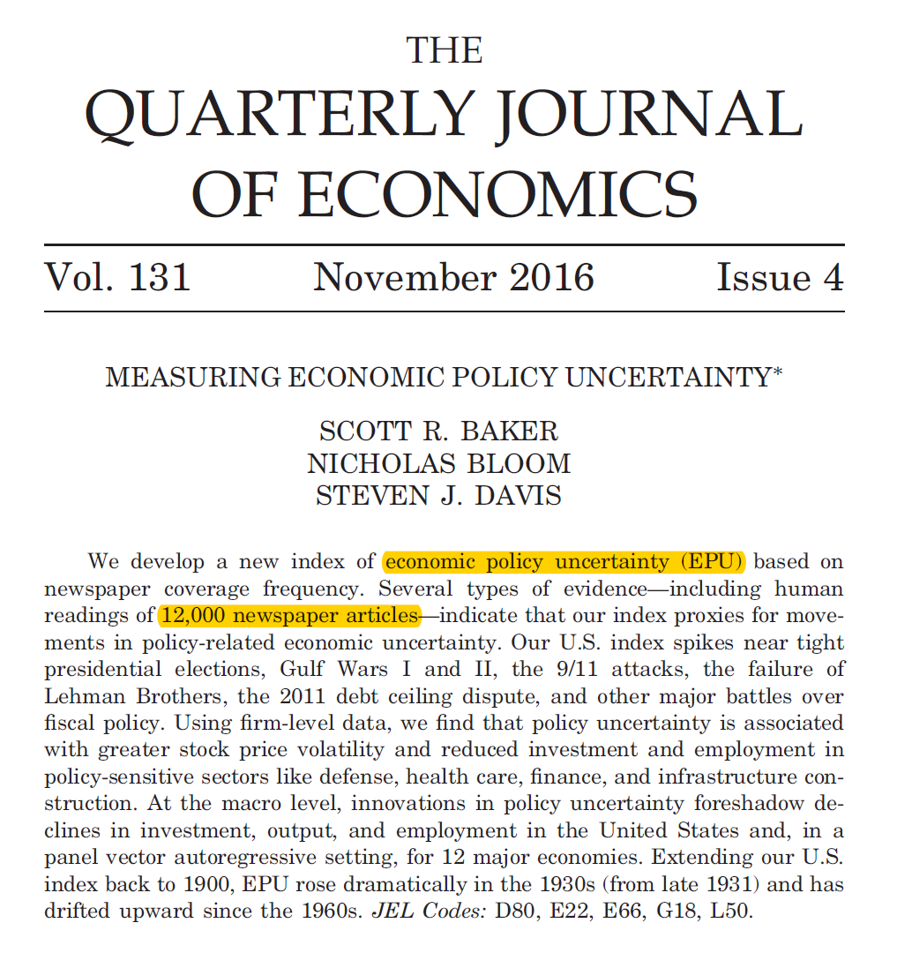
1. INTRODUCTION ▶ Literature Review
Introduction
Main Findings
Sample and Variables
Res. Design and Results
Conclusion
“Many recent studies rely on an influential index of U.S. aggregate economic policy uncertainty (EPU) based on textual analysis of 12,000 newspaper articles” : Baker, Bloom, and Davis (2016)
Obtain a monthly count of articles that contain the following trio of terms
Articles from 10 leading newspapers:
①USA Today, ②Miami Herald,
③Chicago Tribune, ④Washington Post,
⑤Los Angeles Times, ⑥Boston Globe,
⑦San Francisco Chronicle, ⑧Dallas Morning News,
⑨New York Times, ⑩Wall Street Journal
① {"uncertainty", "uncertain"}
② {"economic", "economy"}
③ {"Congress", "deficit", "Federal Reserve", "legislation",
"regulation", "White House"}
Tarek A Hassan, Stephan Hollander, Laurence van Lent, Ahmed Tahoun. The Quarterly Journal of Economics: November 2019, Vol. 134, Issue 4, pp. 2135-2202.

Slide 13
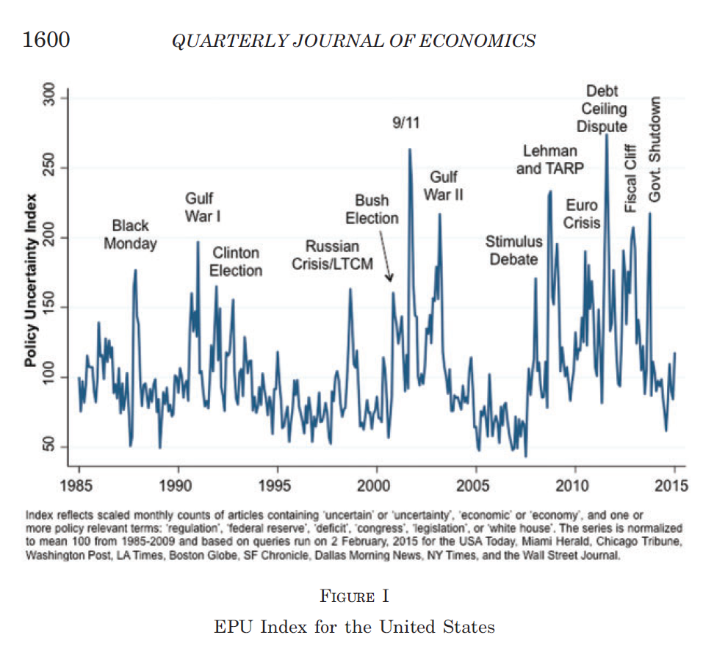
1. INTRODUCTION ▶ Literature Review
Introduction
Main Findings
Sample and Variables
Res. Design and Results
Conclusion
“Many recent studies rely on an influential index of U.S. aggregate economic policy uncertainty (EPU) based on textual analysis of 12,000 newspaper articles” : Baker, Bloom, and Davis (2016)
Tarek A Hassan, Stephan Hollander, Laurence van Lent, Ahmed Tahoun. The Quarterly Journal of Economics: November 2019, Vol. 134, Issue 4, pp. 2135-2202.

Slide 14
1. INTRODUCTION ▶ Literature Review
Introduction
Main Findings
Sample and Variables
Res. Design and Results
Conclusion
“Conventional models predict that an increase in any kind of risk, and therefore an increase in the firm’s political risk, should trigger a rise in the firm’s stock return volatility and decrease its investment and employment growth” : Pindyck 1988; Bloom, Bond, and Van Reenen 2007
Stock return volatility
Risks
Investment
passive
reaction
Employment growth
Tarek A Hassan, Stephan Hollander, Laurence van Lent, Ahmed Tahoun. The Quarterly Journal of Economics: November 2019, Vol. 134, Issue 4, pp. 2135-2202.

Slide 15
1. INTRODUCTION ▶ Literature Review
Introduction
Main Findings
Sample and Variables
Res. Design and Results
Conclusion
“Firms may also “actively” manage political risk by donating to political campaigns or lobbying politicians” : Tullock 1967; Peltzman 1976
“Such “active” management of political risks, however, should be concentrated among large but not small firms, because large firms internalize more of the gain from swaying political decisions than small firms”| : Olson 1965
Donate to political campaigns
Risks
Lobby politicians
active
reaction
Especially, by large firms
Tarek A Hassan, Stephan Hollander, Laurence van Lent, Ahmed Tahoun. The Quarterly Journal of Economics: November 2019, Vol. 134, Issue 4, pp. 2135-2202.

Slide 16
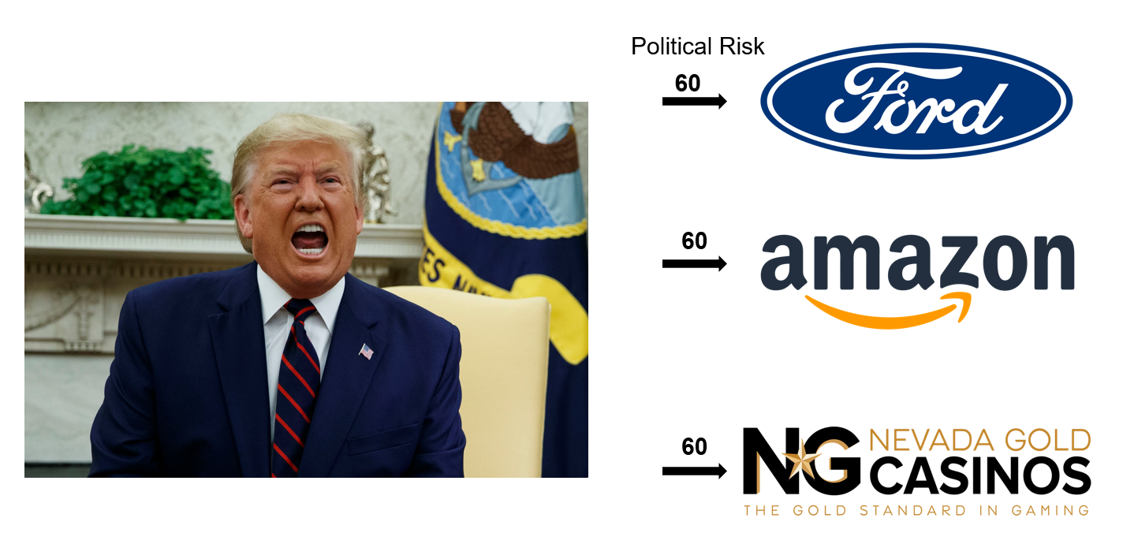
1. INTRODUCTION ▶ Literature Review
Introduction
Main Findings
Sample and Variables
Res. Design and Results
Conclusion
“Our main conclusion from these analyses is that much of the economic impact of political risk is not well described by conventional models in which individual firms have relatively stable exposures to aggregate political risk” : Pastor and Veronesi 2012; Baker, Bloom, and Davis 2016
Not stable across firms
(Hassan et al.)
Tarek A Hassan, Stephan Hollander, Laurence van Lent, Ahmed Tahoun. The Quarterly Journal of Economics: November 2019, Vol. 134, Issue 4, pp. 2135-2202.

Slide 17
1. INTRODUCTION ▶ Literature Review
Introduction
Main Findings
Sample and Variables
Res. Design and Results
Conclusion
Summary of Literature Review
“We adapt a simple pattern-based sequence classification method developed in computational linguistics” : Song and Wu 2008; Manning, Raghavan, and Schütze 2008
“Many recent studies rely on an influential index of U.S. aggregate economic policy uncertainty (EPU) based on textual analysis of 12,000 newspaper articles” : Baker, Bloom, and Davis (2016)
“Conventional models predict that an increase in any kind of risk, and therefore an increase in the firm’s political risk, should trigger a rise in the firm’s stock return volatility and decrease its investment and employment growth” : Pindyck 1988; Bloom, Bond, and Van Reenen 2007
“Firms may also “actively” manage political risk by donating to political campaigns or lobbying politicians” : Tullock 1967; Peltzman 1976
“Such “active” management of political risks, however, should be concentrated among large but not small firms, because large firms internalize more of the gain from swaying political decisions than small firms” : Olson 1965
Tarek A Hassan, Stephan Hollander, Laurence van Lent, Ahmed Tahoun. The Quarterly Journal of Economics: November 2019, Vol. 134, Issue 4, pp. 2135-2202.

Slide 18
2. Main Findings

Slide 19
2. MAIN FINDINGS
Introduction
Main Findings
Sample
Res. Design and Results
Conclusion
F1
Measure political risk at the firm level
Define a measure of political risk
Define additional measures of risk and sentiment
Construct training libraries
Validation test
Tarek A Hassan, Stephan Hollander, Laurence van Lent, Ahmed Tahoun. The Quarterly Journal of Economics: November 2019, Vol. 134, Issue 4, pp. 2135-2202.

Slide 20
2. MAIN FINDINGS
Introduction
Main Findings
Sample
Res. Design and Results
Conclusion
F1
Measure political risk at the firm level
Define a measure of political risk
Define additional measures of risk and sentiment
Construct training libraries
Validation test
F2
Manage political risk
Mean vs. variance of political shocks
Falsification exercises
Choice of training libraries and alternative implementations of political risk measure
Tarek A Hassan, Stephan Hollander, Laurence van Lent, Ahmed Tahoun. The Quarterly Journal of Economics: November 2019, Vol. 134, Issue 4, pp. 2135-2202.

Slide 21
2. MAIN FINDINGS
Introduction
Main Findings
Sample
Res. Design and Results
Conclusion
F3
Focus on firm-level political risk
Find macroeconomic effects of firm-level political risk
Find different political risk patterns by two distinct firms
F4
Measure topic-specific political risk
Construct PRisk by Topic (with Validation check)
Find that firms lobby by political topics
Tarek A Hassan, Stephan Hollander, Laurence van Lent, Ahmed Tahoun. The Quarterly Journal of Economics: November 2019, Vol. 134, Issue 4, pp. 2135-2202.

Slide 22
3. Sample and Main Variables

Slide 23
3. SAMPLE AND VARIABLES
Introduction
Main Findings
Sample and Variables
Res. Design and Results
Conclusion
Sample Data
※ Target Year and Firm
Year: 2002 - 2016
Target Firm: 7,357 firms listed in the United States
※ Data
Earnings conference calls (from Thomson Reuters' StreetEvents): 178,173
Lobbying and donating to politicians:
Quarterly total expenditure on lobbying Congress (from the Center for Responsive Politics (CRP))
Campaign contributions by Political Action Committees (PACs) (from the CRP website)
Government contracts (from USAspending.gov)
Stock information (from CRSP)
(Firm-quarter-level) implied volatility (from OptionMetrics)
Capital expenditure (from I/B/E/S Guidance)
Employment, investment, and income statement information (from Compustat)
Tarek A Hassan, Stephan Hollander, Laurence van Lent, Ahmed Tahoun. The Quarterly Journal of Economics: November 2019, Vol. 134, Issue 4, pp. 2135-2202.

Slide 24
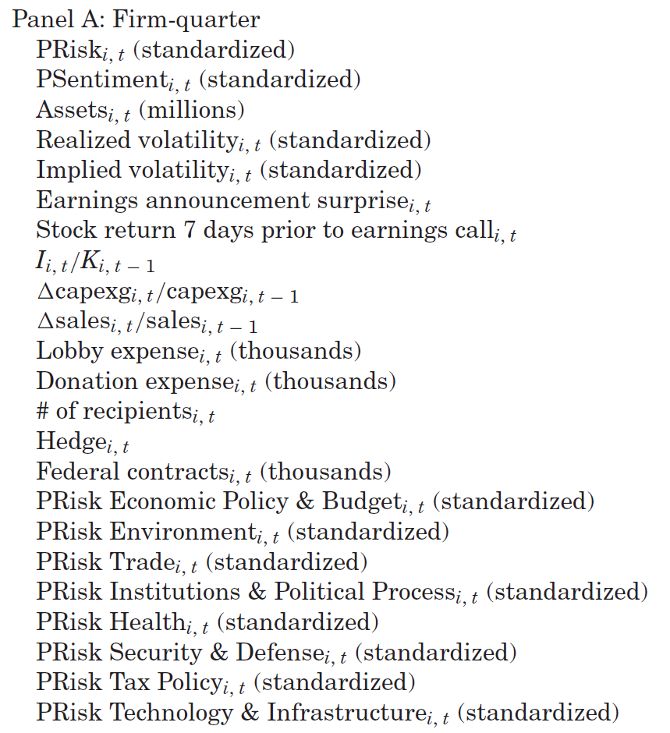
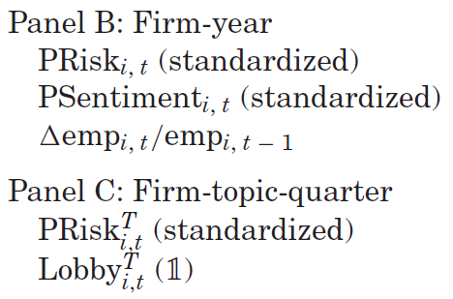
3. SAMPLE AND VARIABLES
Introduction
Main Findings
Sample and Variables
Res. Design and Results
Conclusion
Main Variables
Tarek A Hassan, Stephan Hollander, Laurence van Lent, Ahmed Tahoun. The Quarterly Journal of Economics: November 2019, Vol. 134, Issue 4, pp. 2135-2202.

Slide 25
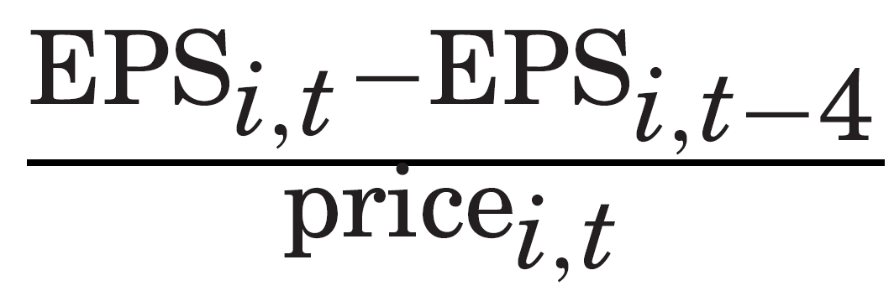
3. SAMPLE AND VARIABLES
Introduction
Main Findings
Sample and Variables
Res. Design and Results
Conclusion
Main Variables
Realized Volatility → measure of firm-level economic uncertainty : the standard deviation of daily stock holding returns of firm i in quarter t
Implied volatility → measure of firm-level economic uncertainty : 90-day at-the-money options of firm i and time t
Earnings announcement surprise → measure of recent performance :
Stock return 7 days prior to earnings call → measure of recent performance
(Ball and Bartov 1996)
Tarek A Hassan, Stephan Hollander, Laurence van Lent, Ahmed Tahoun. The Quarterly Journal of Economics: November 2019, Vol. 134, Issue 4, pp. 2135-2202.

Slide 26
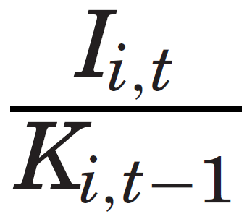
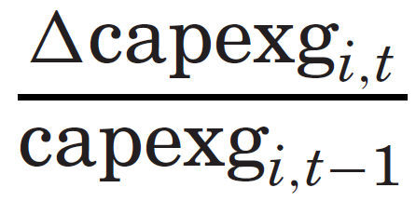
3. SAMPLE AND VARIABLES
Introduction
Main Findings
Sample and Variables
Res. Design and Results
Conclusion
Main Variables
Capital investment → measure of a firm's investment growth :
Capex guidance (change in the guidance for total capital expenditure for the next fiscal year) → measure of a firm's investment growth :
Sales growth → Baker et al. document that larger short-run effects of risk exist on hard-to-reverse investments in physical and human capital than on short-run output growth
Net hiring → measure of a firm's employment growth
(perpetual-inventory method, Stein and Stone 2013)
Tarek A Hassan, Stephan Hollander, Laurence van Lent, Ahmed Tahoun. The Quarterly Journal of Economics: November 2019, Vol. 134, Issue 4, pp. 2135-2202.

Slide 27
3. SAMPLE AND VARIABLES
Introduction
Main Findings
Sample and Variables
Res. Design and Results
Conclusion
Main Variables
Lobby expense → measure of a firm's positive reaction to political risks
Donation expense → measure of a firm's positive reaction to political risks
# of recipients → measure of a firm's positive reaction to political risks : the total number of recipients of donations made in quarter t by firm i
Hedge → measure of a firm's positive reaction to political risks : dummy variable equal to 1 if donations to Republicans over donations to Democrats are between the 25th and 75th percentile of the sample
Federal contracts → measure of a firm's government dependence : the net value from all federal contracts of firm i in quarter t
Tarek A Hassan, Stephan Hollander, Laurence van Lent, Ahmed Tahoun. The Quarterly Journal of Economics: November 2019, Vol. 134, Issue 4, pp. 2135-2202.

Slide 28
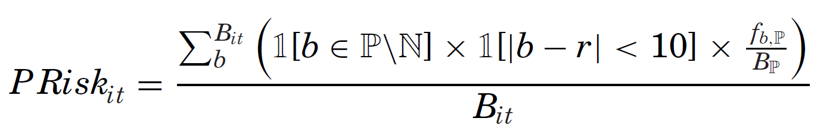
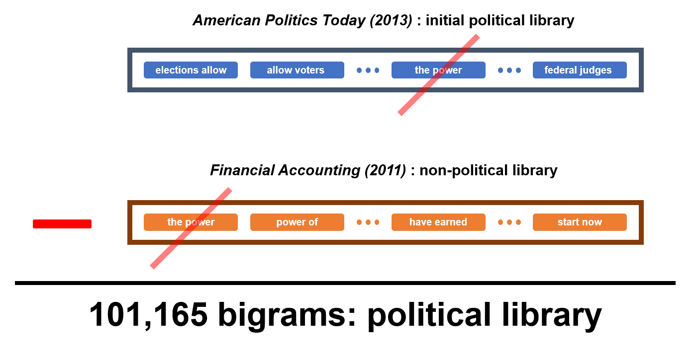
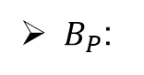
3. SAMPLE AND VARIABLES
Introduction
Main Findings
Sample and Variables
Res. Design and Results
Conclusion
Main Variables
$B_{P}$:
Non-political keyword: e.g., "performance"
Newspaper articles
from Factiva
Political keyword: "domestic politics"
hybrid political library with 200,000 bigrams
Tarek A Hassan, Stephan Hollander, Laurence van Lent, Ahmed Tahoun. The Quarterly Journal of Economics: November 2019, Vol. 134, Issue 4, pp. 2135-2202.

Slide 29
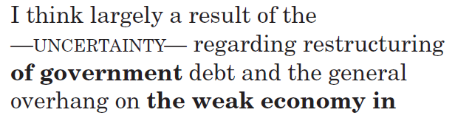
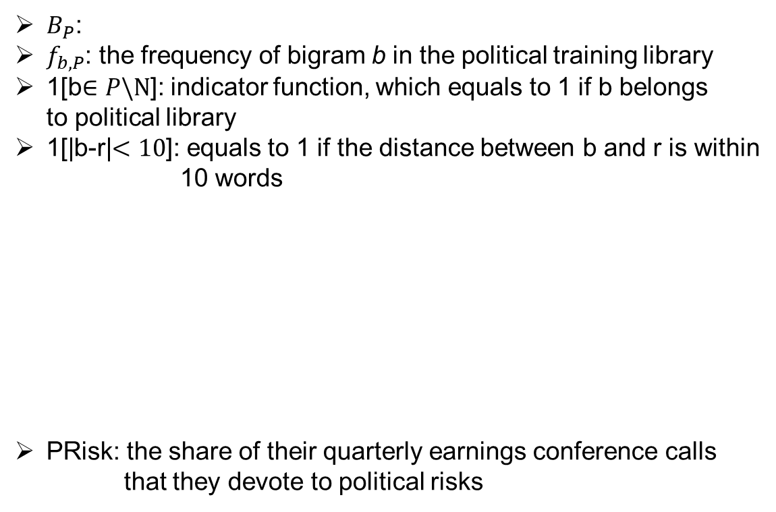
3. SAMPLE AND VARIABLES
Introduction
Main Findings
Sample and Variables
Res. Design and Results
Conclusion
Main Variables
hybrid political library with 200,000 bigrams
$B_{P}$:
$f_{b, P}$: the frequency of bigram b in the political training library
1[b$∈P\backslash N$]: indicator function, which equals to 1 if b belongs to political library
1[|b-r|$<10$]: equals to 1 if the distance between b and r is within 10 words
PRisk: the share of their quarterly earnings conference calls that they devote to political risks
- r : Synonym for "risk" and "uncertainty"
- e.g.,
10th
Tarek A Hassan, Stephan Hollander, Laurence van Lent, Ahmed Tahoun. The Quarterly Journal of Economics: November 2019, Vol. 134, Issue 4, pp. 2135-2202.

Slide 30
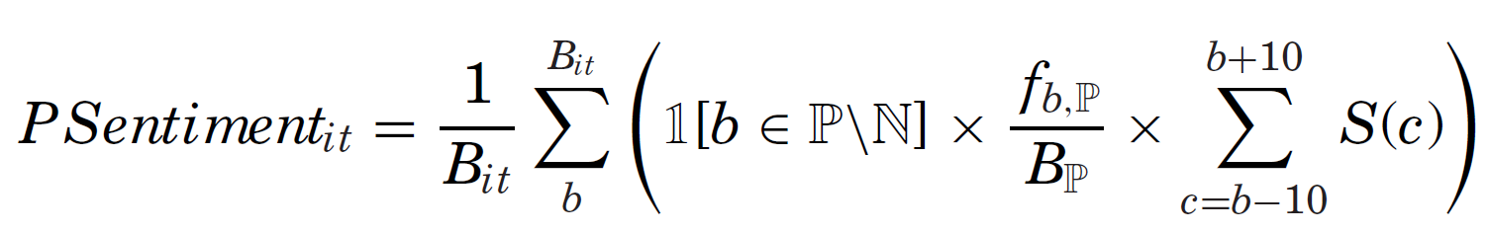
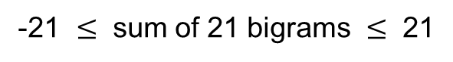
3. SAMPLE AND VARIABLES
Introduction
Main Findings
Sample and Variables
Res. Design and Results
Conclusion
Main Variables
S(c): equals +1 if the bigram c is associated with positive sentiment (using Loughran and McDonald 2011’s sentiment dictionary); equals -1 if associated with negative sentiment
e.g.
of government
POS POS
NEU NEU
NEG NEG
POS POS
-21 $≤$ sum of 21 bigrams $≤$ 21
Tarek A Hassan, Stephan Hollander, Laurence van Lent, Ahmed Tahoun. The Quarterly Journal of Economics: November 2019, Vol. 134, Issue 4, pp. 2135-2202.

Slide 31
3. SAMPLE AND VARIABLES
Introduction
Main Findings
Sample and Variables
Res. Design and Results
Conclusion
Main Variables
PRisk by 8 Topics:
① Economic Policy and Budget
② Environment
③ Trade
④ Institutions and Political Process
⑤ Health
⑥ Security and Defense
⑦ Tax Policy
⑧ Technology and Infrastructure
Sources are from OnTheIssues.org, which educates voters about the positions politicians take on key topics
Other processes are equal to the abovementioned methods
Tarek A Hassan, Stephan Hollander, Laurence van Lent, Ahmed Tahoun. The Quarterly Journal of Economics: November 2019, Vol. 134, Issue 4, pp. 2135-2202.

Slide 32
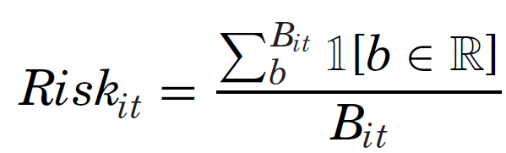
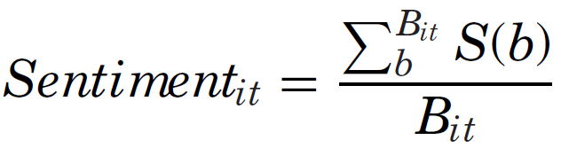
3. SAMPLE AND VARIABLES
Introduction
Main Findings
Sample and Variables
Res. Design and Results
Conclusion
Main Variables
Tarek A Hassan, Stephan Hollander, Laurence van Lent, Ahmed Tahoun. The Quarterly Journal of Economics: November 2019, Vol. 134, Issue 4, pp. 2135-2202.

Slide 33
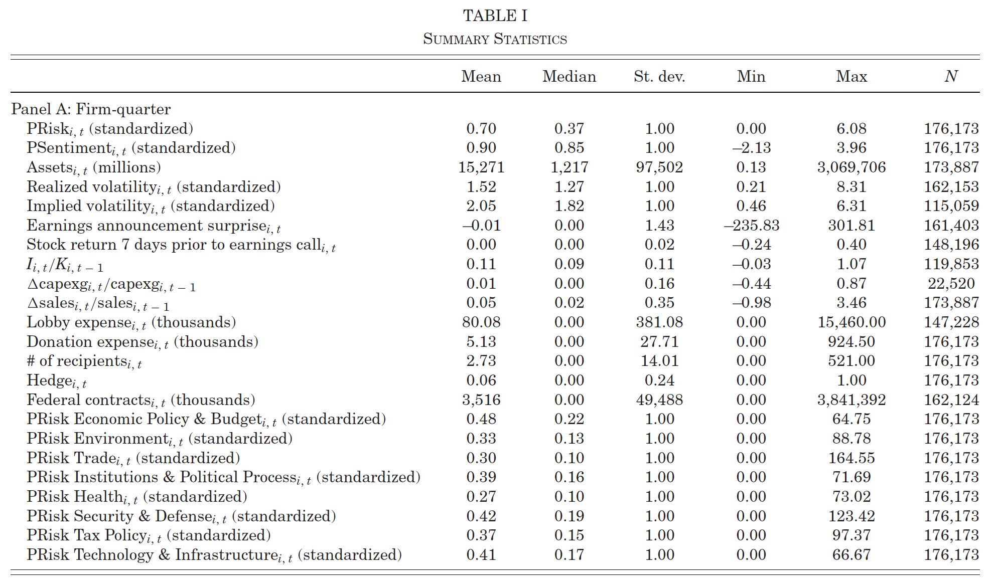
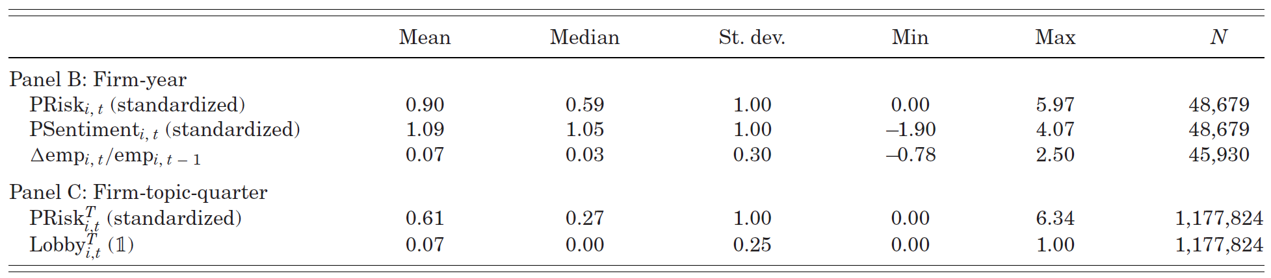
3. SAMPLE AND VARIABLES
Introduction
Main Findings
Sample and Variables
Res. Design and Results
Conclusion
Descriptive Statistics
Tarek A Hassan, Stephan Hollander, Laurence van Lent, Ahmed Tahoun. The Quarterly Journal of Economics: November 2019, Vol. 134, Issue 4, pp. 2135-2202.

Slide 34
4. Research Design and Results

Slide 35
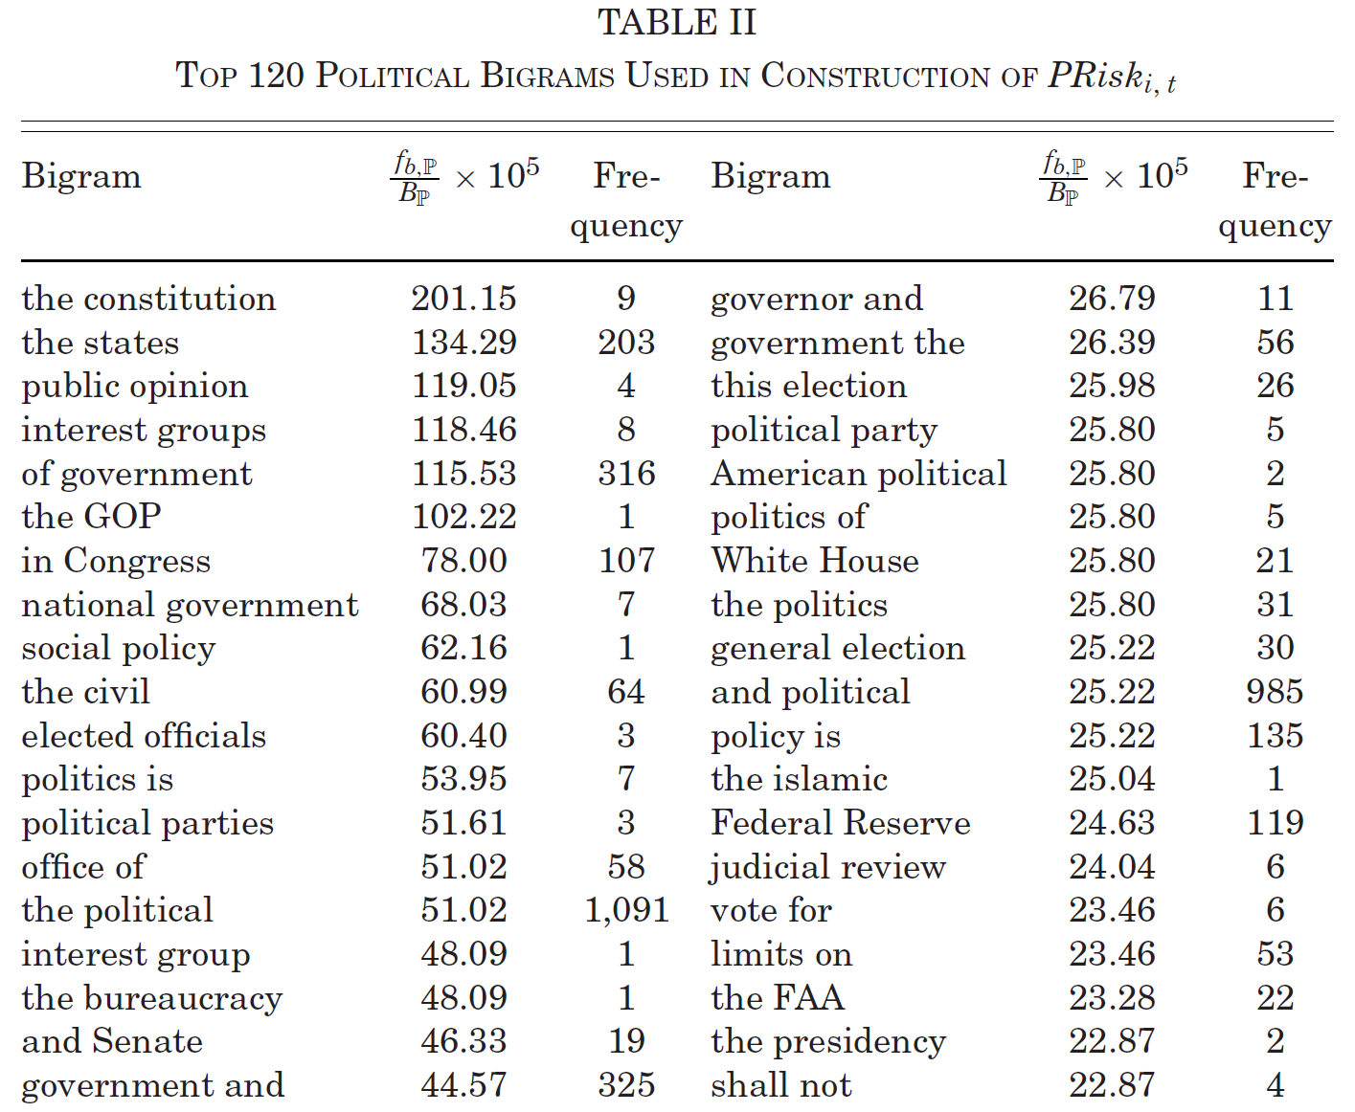
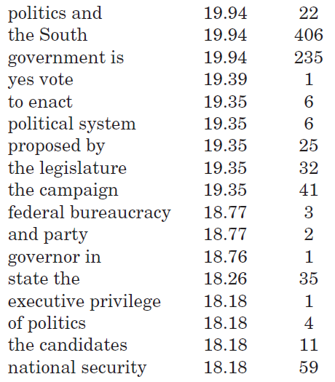
4. RESEARCH DESIGN AND RESULTS
Introduction
Main Findings
Sample and Variables
Res. Design and Results
Conclusion
Top Political Bigrams
# repeated in the political library
Conf. Calls # 1: O
01
02
03
04
05
06
07
08
09
10
11
12
13
14
15
16
17
18
19
Conf. Calls
# 2: X
104
105
106
107
108
109
110
111
112113
114
115
116
117
118
119
120
Conf. Calls # 178,172: O
Conf. Calls # 178,173: O
Tarek A Hassan, Stephan Hollander, Laurence van Lent, Ahmed Tahoun. The Quarterly Journal of Economics: November 2019, Vol. 134, Issue 4, pp. 2135-2202.

Slide 36
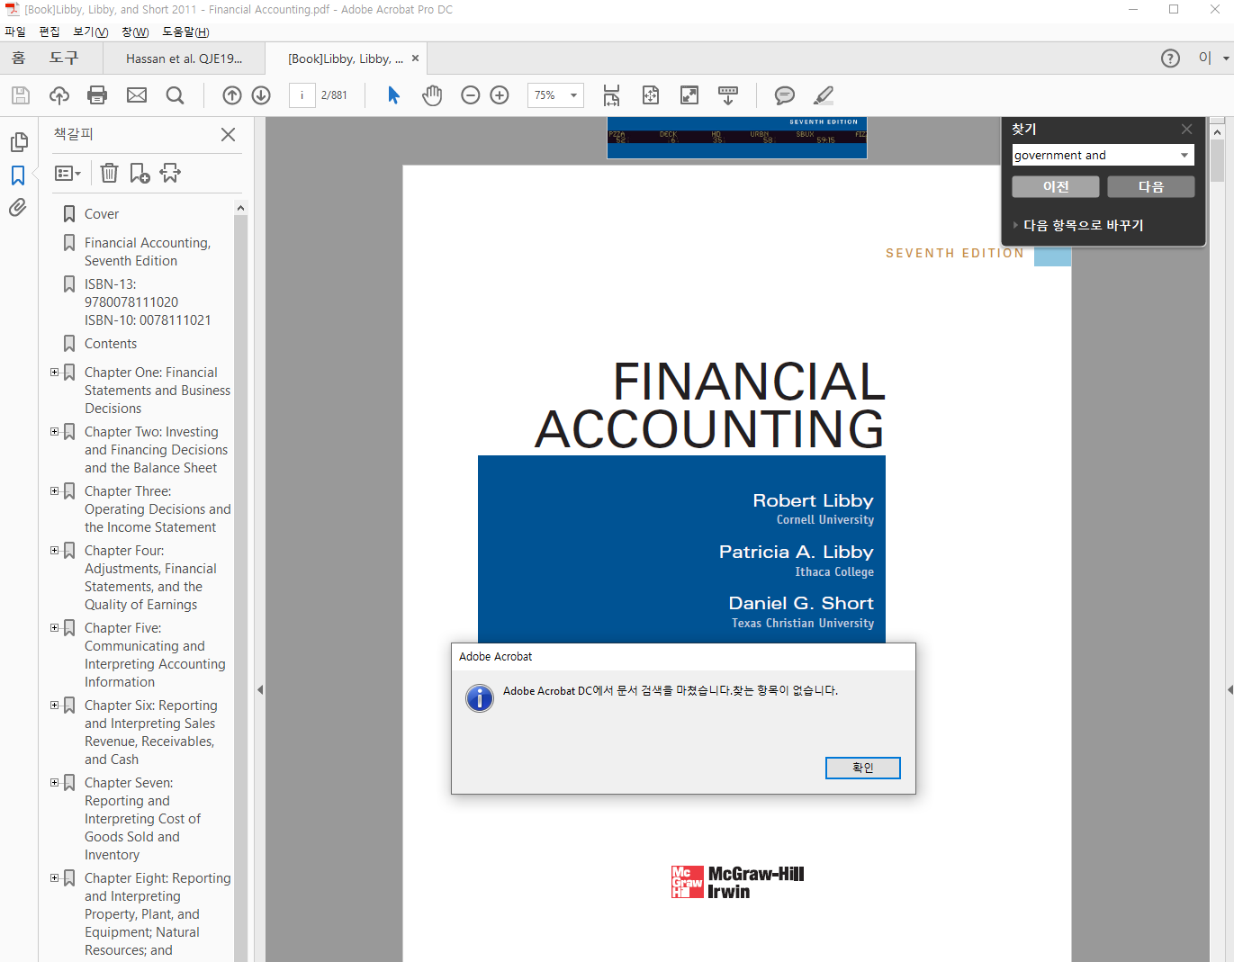
4. RESEARCH DESIGN AND RESULTS
Introduction
Main Findings
Sample and Variables
Res. Design and Results
Conclusion
Top Political Bigrams
01
02
03
04
05
06
07
08
09
10
11
12
13
14
15
16
17
18
19
104
105
106
107
108
109
110
111
112113
114
115
116
117
118
119
120
Tarek A Hassan, Stephan Hollander, Laurence van Lent, Ahmed Tahoun. The Quarterly Journal of Economics: November 2019, Vol. 134, Issue 4, pp. 2135-2202.

Slide 37
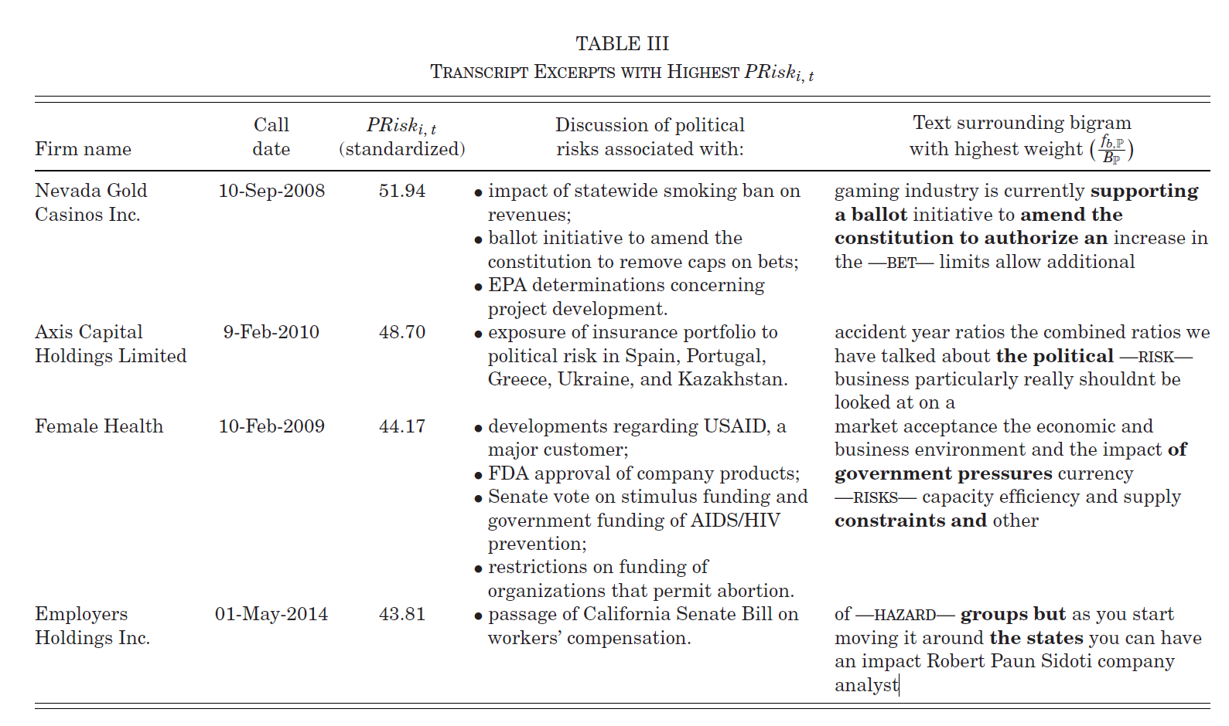
4. RESEARCH DESIGN AND RESULTS
Introduction
Main Findings
Sample and Variables
Res. Design and Results
Conclusion
Validation Test (1): Higher PRisk → Mentions more about political risks
Tarek A Hassan, Stephan Hollander, Laurence van Lent, Ahmed Tahoun. The Quarterly Journal of Economics: November 2019, Vol. 134, Issue 4, pp. 2135-2202.

Slide 38
4. RESEARCH DESIGN AND RESULTS
Introduction
Main Findings
Sample and Variables
Res. Design and Results
Conclusion
Validation Test (1): Higher PRisk → Mentions more about political risks
19/20 relate to political risks : e.g., government funding and legislation
Tarek A Hassan, Stephan Hollander, Laurence van Lent, Ahmed Tahoun. The Quarterly Journal of Economics: November 2019, Vol. 134, Issue 4, pp. 2135-2202.

Slide 39
4. RESEARCH DESIGN AND RESULTS
Introduction
Main Findings
Sample and Variables
Res. Design and Results
Conclusion
Validation Test (1): Higher PRisk → Mentions more about political risks
The only one false positive is caused due to the abnormally short transcript: only 6 pages
Tarek A Hassan, Stephan Hollander, Laurence van Lent, Ahmed Tahoun. The Quarterly Journal of Economics: November 2019, Vol. 134, Issue 4, pp. 2135-2202.

Slide 40
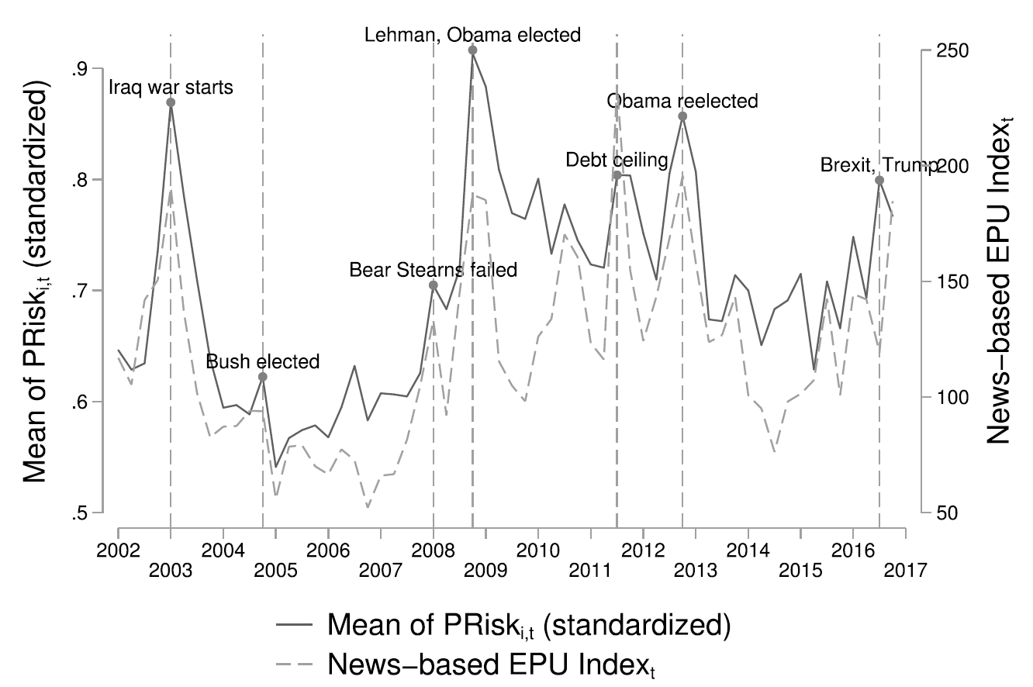
4. RESEARCH DESIGN AND RESULTS
Introduction
Main Findings
Sample and Variables
Res. Design and Results
Conclusion
Validation Test (2): Is PRisk correlated with the other measure associated with political risks?
Hassan et al.
2019
Baker et al.
2016
.
Tarek A Hassan, Stephan Hollander, Laurence van Lent, Ahmed Tahoun. The Quarterly Journal of Economics: November 2019, Vol. 134, Issue 4, pp. 2135-2202.

Slide 41
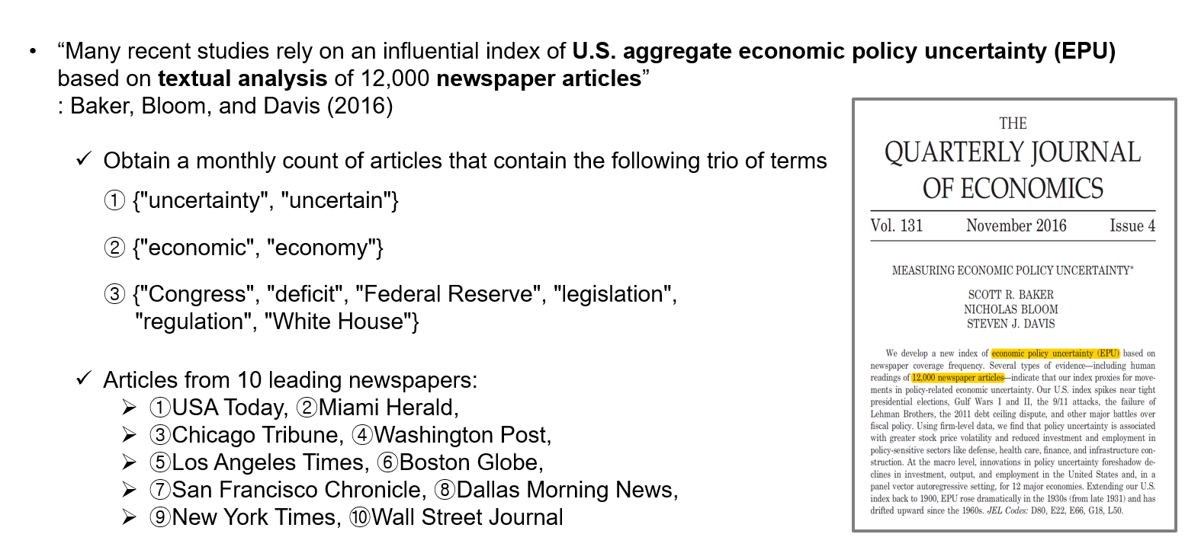
4. RESEARCH DESIGN AND RESULTS
Introduction
Main Findings
Sample and Variables
Res. Design and Results
Conclusion
Validation Test (2): Is PRisk correlated with the other measure associated with political risks?
Tarek A Hassan, Stephan Hollander, Laurence van Lent, Ahmed Tahoun. The Quarterly Journal of Economics: November 2019, Vol. 134, Issue 4, pp. 2135-2202.

Slide 42
4. RESEARCH DESIGN AND RESULTS
Introduction
Main Findings
Sample and Variables
Res. Design and Results
Conclusion
Validation Test (2): Is PRisk correlated with the other measure associated with political risks?
Hassan et al.
2019
Baker et al.
2016
.
Tarek A Hassan, Stephan Hollander, Laurence van Lent, Ahmed Tahoun. The Quarterly Journal of Economics: November 2019, Vol. 134, Issue 4, pp. 2135-2202.

Slide 43
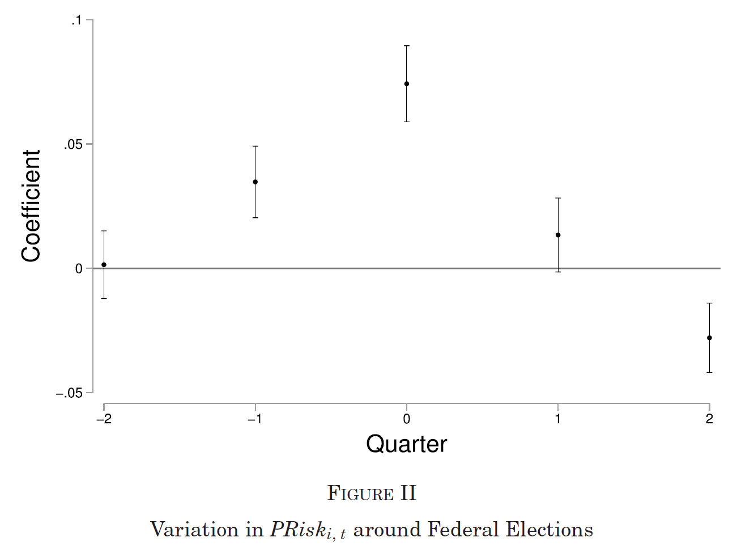
4. RESEARCH DESIGN AND RESULTS
Introduction
Main Findings
Sample and Variables
Res. Design and Results
Conclusion
Validation Test (3): Does the mean of PRisk change over time?
Tarek A Hassan, Stephan Hollander, Laurence van Lent, Ahmed Tahoun. The Quarterly Journal of Economics: November 2019, Vol. 134, Issue 4, pp. 2135-2202.

Slide 44
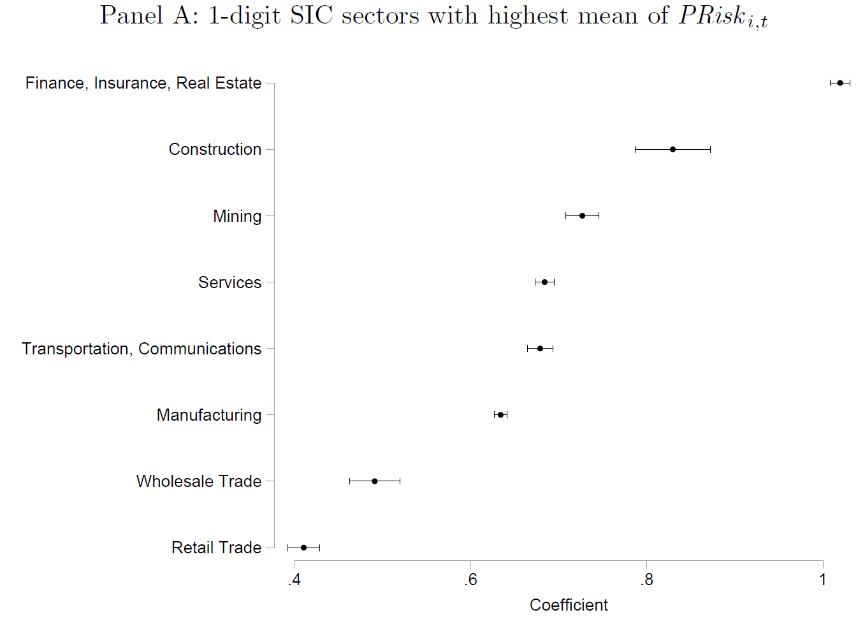
4. RESEARCH DESIGN AND RESULTS
Introduction
Main Findings
Sample and Variables
Res. Design and Results
Conclusion
Validation Test (4): Are the means of PRisk different across distinct industry sectors?
Tarek A Hassan, Stephan Hollander, Laurence van Lent, Ahmed Tahoun. The Quarterly Journal of Economics: November 2019, Vol. 134, Issue 4, pp. 2135-2202.

Slide 45
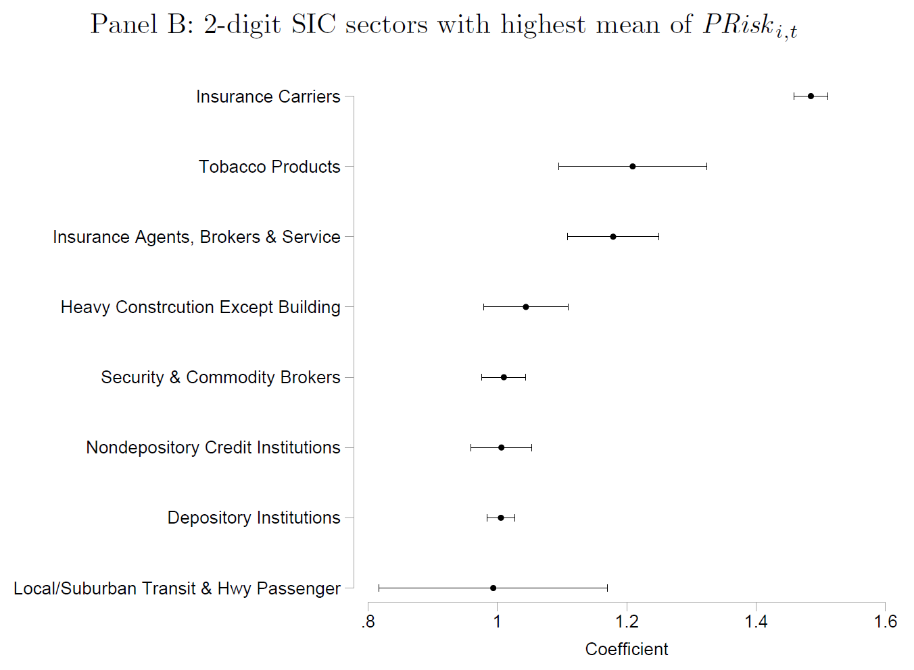
4. RESEARCH DESIGN AND RESULTS
Introduction
Main Findings
Sample and Variables
Res. Design and Results
Conclusion
Validation Test (4): Are the means of PRisk different across distinct industry sectors?
Tarek A Hassan, Stephan Hollander, Laurence van Lent, Ahmed Tahoun. The Quarterly Journal of Economics: November 2019, Vol. 134, Issue 4, pp. 2135-2202.

Slide 46

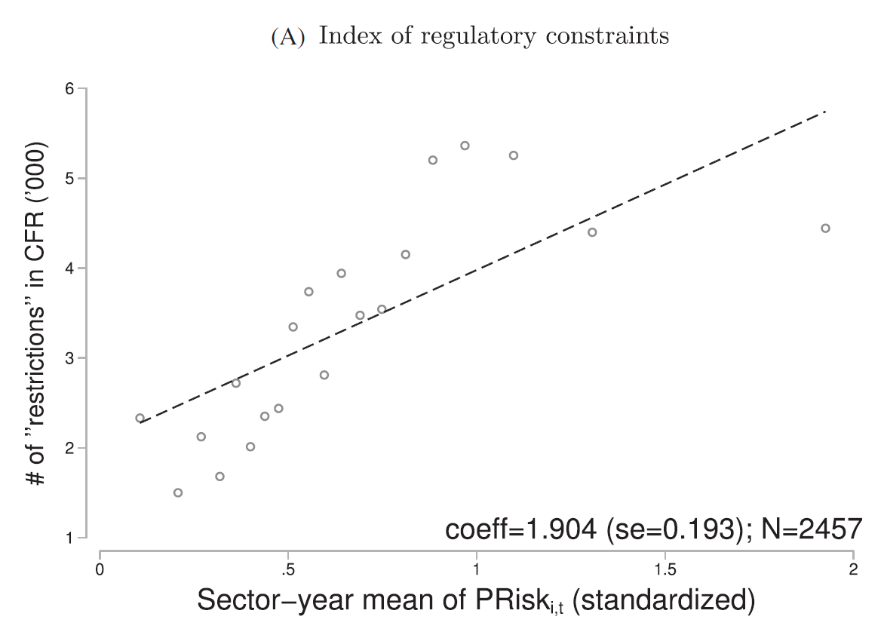
4. RESEARCH DESIGN AND RESULTS
Introduction
Main Findings
Sample and Variables
Res. Design and Results
Conclusion
Validation Test (5): Is PRisk correlated with an index of sector-specific regulatory constraints?
Suggested by Al-Ubaydli and McLaughlin (2017)
CFR: the Code of Federal Regulations
Restrictive words: "must," "may not," "prohibited," and "required"
Sector: two-digit sector → herein, 211 industries
Tarek A Hassan, Stephan Hollander, Laurence van Lent, Ahmed Tahoun. The Quarterly Journal of Economics: November 2019, Vol. 134, Issue 4, pp. 2135-2202.

Slide 47
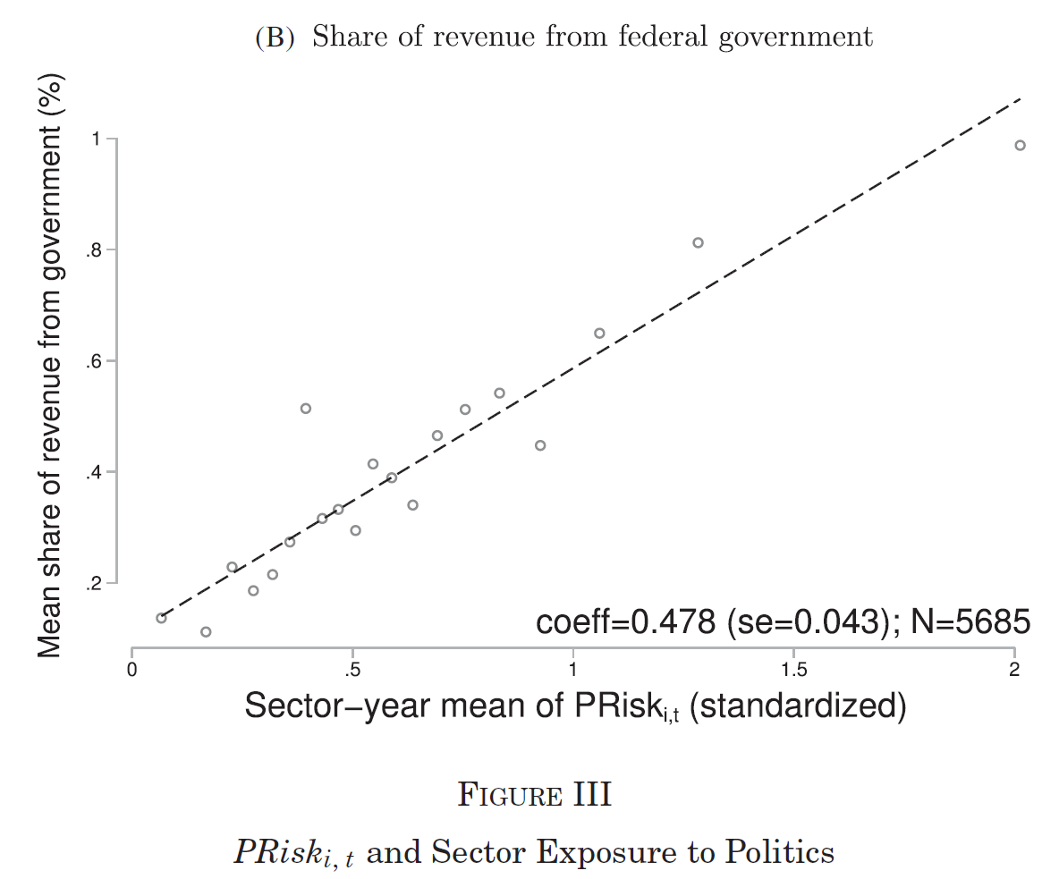
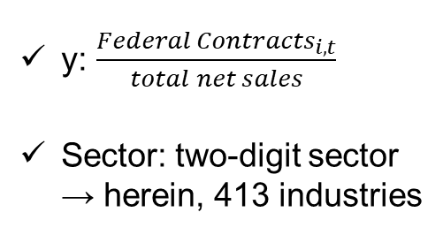
4. RESEARCH DESIGN AND RESULTS
Introduction
Main Findings
Sample and Variables
Res. Design and Results
Conclusion
Validation Test (6): Is PRisk correlated with the mean share of revenue from government contracts?
y: $\frac{{Federal Contracts}_{i, t}}{total net sales}$
Sector: two-digit sector → herein, 413 industries
Tarek A Hassan, Stephan Hollander, Laurence van Lent, Ahmed Tahoun. The Quarterly Journal of Economics: November 2019, Vol. 134, Issue 4, pp. 2135-2202.

Slide 48
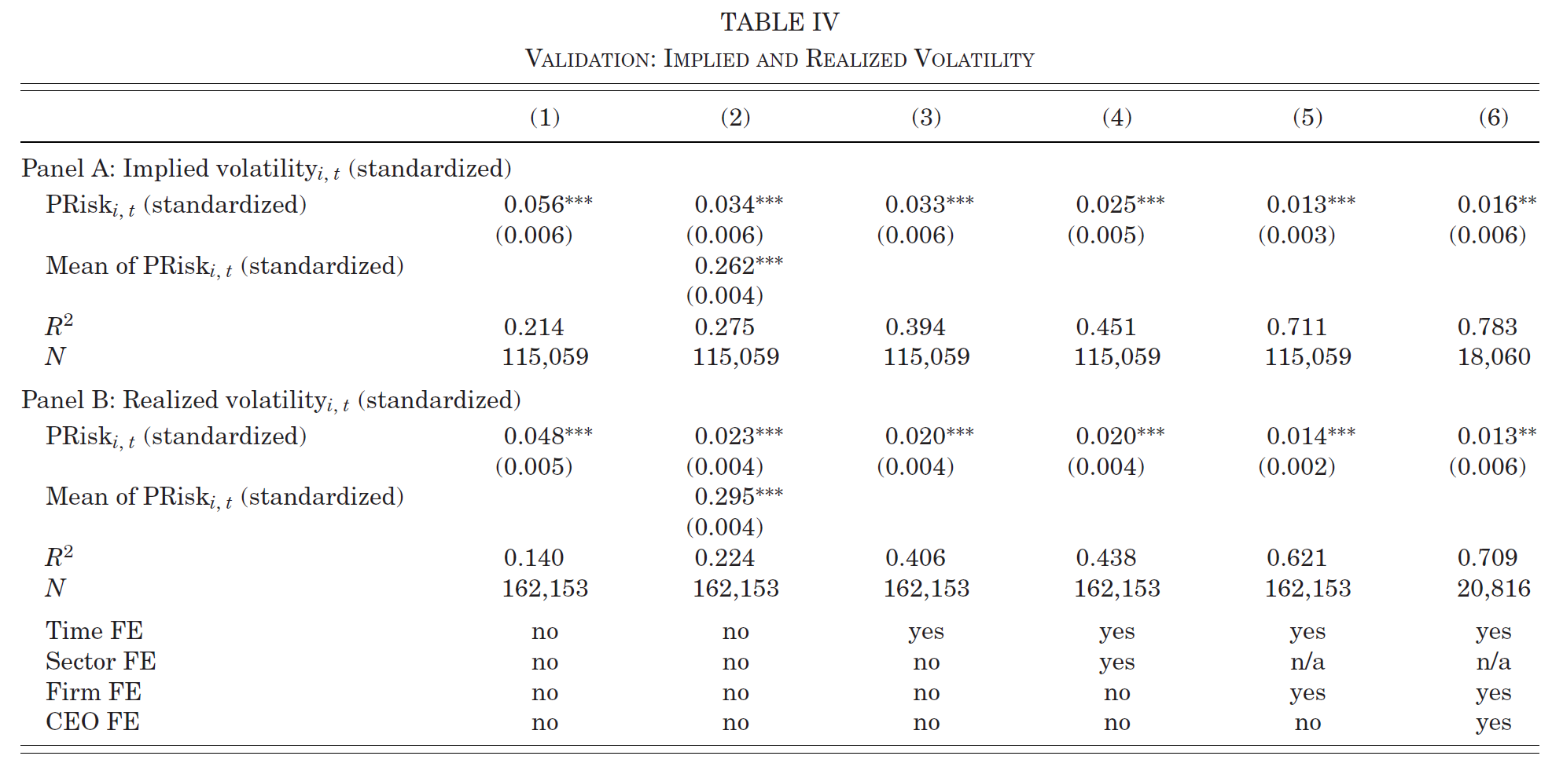
4. RESEARCH DESIGN AND RESULTS
Introduction
Main Findings
Sample and Variables
Res. Design and Results
Conclusion
Validation Test (7): Is PRisk positively associated with firm-level uncertainty measures?
Y: Implied Volatility
X: PRisk
"One standard deviation increase in the time series is associated with 0.262 standard deviation increase in volatility"
Tarek A Hassan, Stephan Hollander, Laurence van Lent, Ahmed Tahoun. The Quarterly Journal of Economics: November 2019, Vol. 134, Issue 4, pp. 2135-2202.

Slide 49
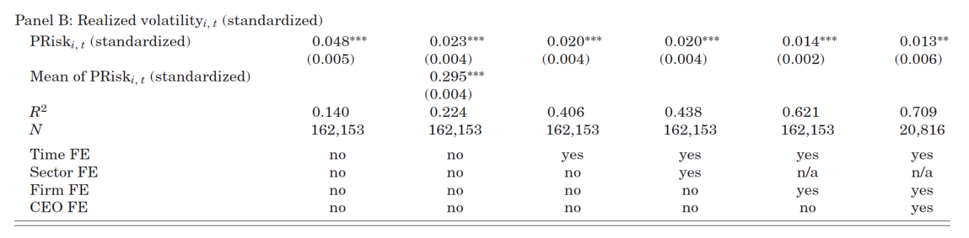
4. RESEARCH DESIGN AND RESULTS
Introduction
Main Findings
Sample and Variables
Res. Design and Results
Conclusion
Validation Test (7): Is PRisk positively associated with firm-level uncertainty measures?
Y: Realized Volatility
X: PRisk
(5)
Tarek A Hassan, Stephan Hollander, Laurence van Lent, Ahmed Tahoun. The Quarterly Journal of Economics: November 2019, Vol. 134, Issue 4, pp. 2135-2202.

Slide 50
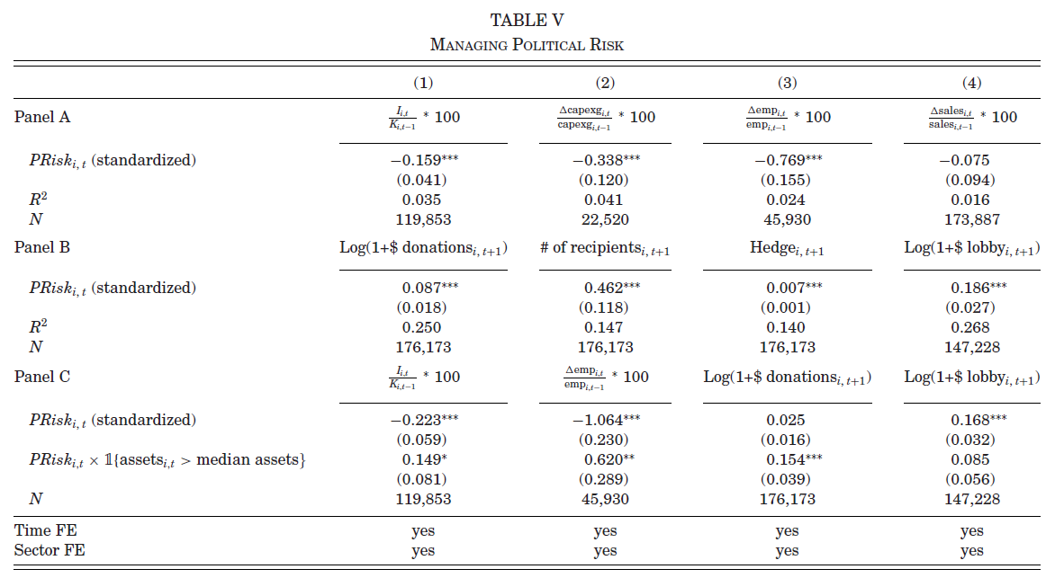
4. RESEARCH DESIGN AND RESULTS
Introduction
Main Findings
Sample and Variables
Res. Design and Results
Conclusion
Hypothesis (1): PRisk is negatively associated with investment and employment growth (↔ sales growth)
(Baker et al. 2016)
Tarek A Hassan, Stephan Hollander, Laurence van Lent, Ahmed Tahoun. The Quarterly Journal of Economics: November 2019, Vol. 134, Issue 4, pp. 2135-2202.

Slide 51
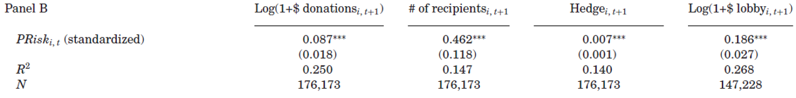
4. RESEARCH DESIGN AND RESULTS
Introduction
Main Findings
Sample and Variables
Res. Design and Results
Conclusion
Hypothesis (2): PRisk is positively associated with the measures of firms' active management of political risks
(Baker et al. 2016)
Tarek A Hassan, Stephan Hollander, Laurence van Lent, Ahmed Tahoun. The Quarterly Journal of Economics: November 2019, Vol. 134, Issue 4, pp. 2135-2202.

Slide 52
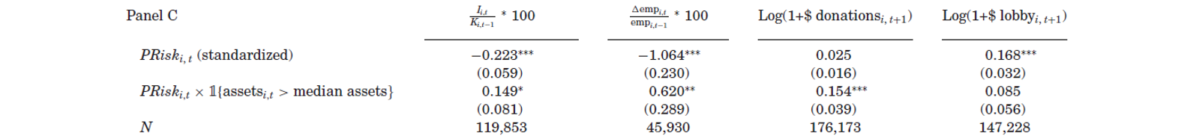
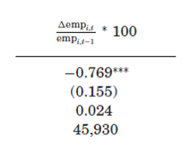
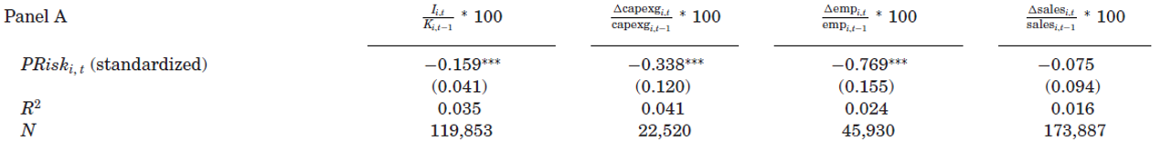
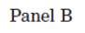
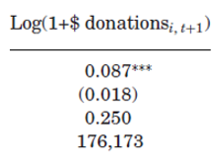
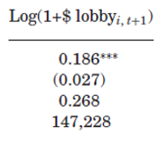
4. RESEARCH DESIGN AND RESULTS
Introduction
Main Findings
Sample and Variables
Res. Design and Results
Conclusion
Hypothesis (3): The extent to which large firms respond to political risks is different from that of small firms
(Olson 1965)
&
Tarek A Hassan, Stephan Hollander, Laurence van Lent, Ahmed Tahoun. The Quarterly Journal of Economics: November 2019, Vol. 134, Issue 4, pp. 2135-2202.

Slide 53
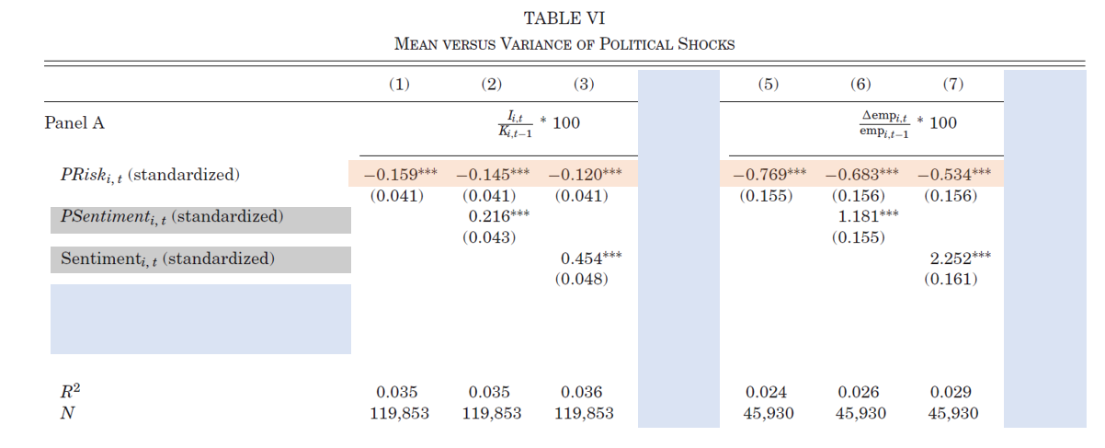
4. RESEARCH DESIGN AND RESULTS
Introduction
Main Findings
Sample and Variables
Res. Design and Results
Conclusion
Robustness Check (1): The significance of PRisk on firms' reactions does not meaningfully decline after adding sentiment variables (robustness check of omitted variables)
Tarek A Hassan, Stephan Hollander, Laurence van Lent, Ahmed Tahoun. The Quarterly Journal of Economics: November 2019, Vol. 134, Issue 4, pp. 2135-2202.

Slide 54
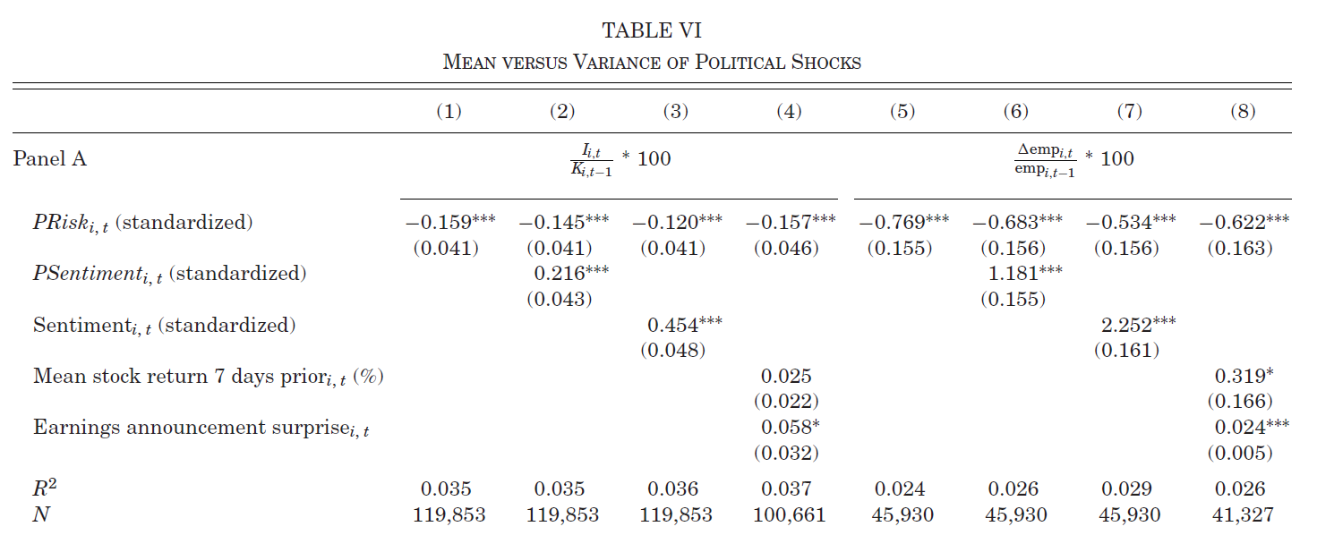
4. RESEARCH DESIGN AND RESULTS
Introduction
Main Findings
Sample and Variables
Res. Design and Results
Conclusion
Robustness Check (2): The significance of PRisk on firms' reactions does not meaningfully decline after adding firms' recent performance variables (robustness check of omitted variables)
Tarek A Hassan, Stephan Hollander, Laurence van Lent, Ahmed Tahoun. The Quarterly Journal of Economics: November 2019, Vol. 134, Issue 4, pp. 2135-2202.

Slide 55
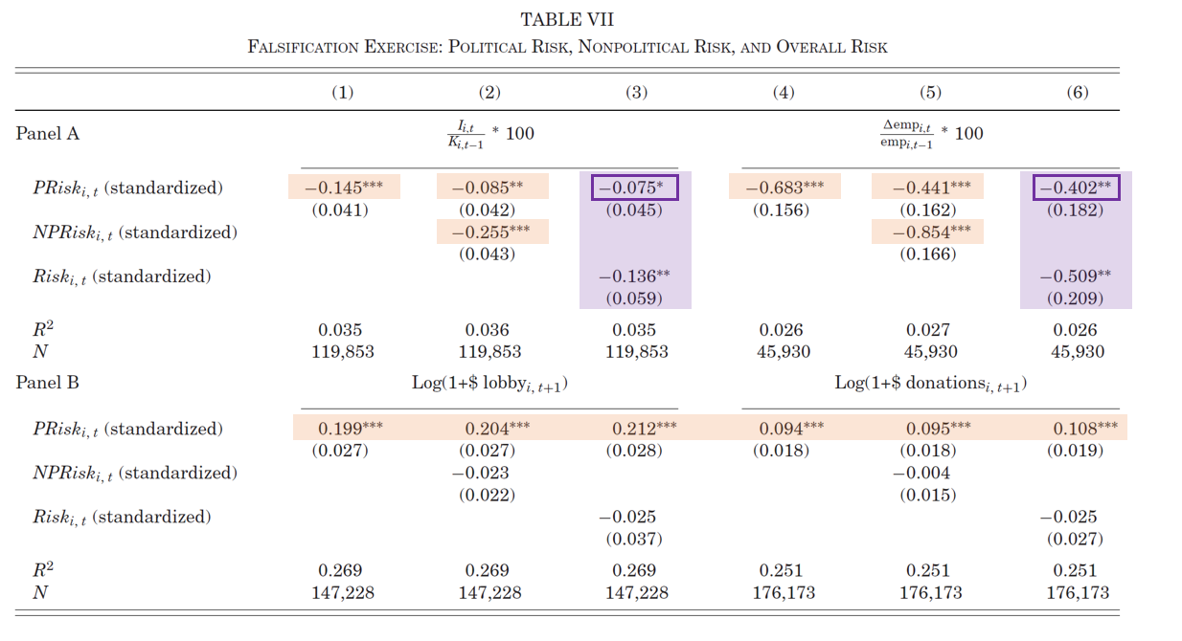
4. RESEARCH DESIGN AND RESULTS
Introduction
Main Findings
Sample and Variables
Res. Design and Results
Conclusion
Robustness Check (3): Falsification Exercise
“If firms indeed retrench hiring and investment due to risks associated with political topics and not for other reasons, the association between PRisk and these outcomes should be significantly attenuated when we control for overall risk. ”
Tarek A Hassan, Stephan Hollander, Laurence van Lent, Ahmed Tahoun. The Quarterly Journal of Economics: November 2019, Vol. 134, Issue 4, pp. 2135-2202.

Slide 56
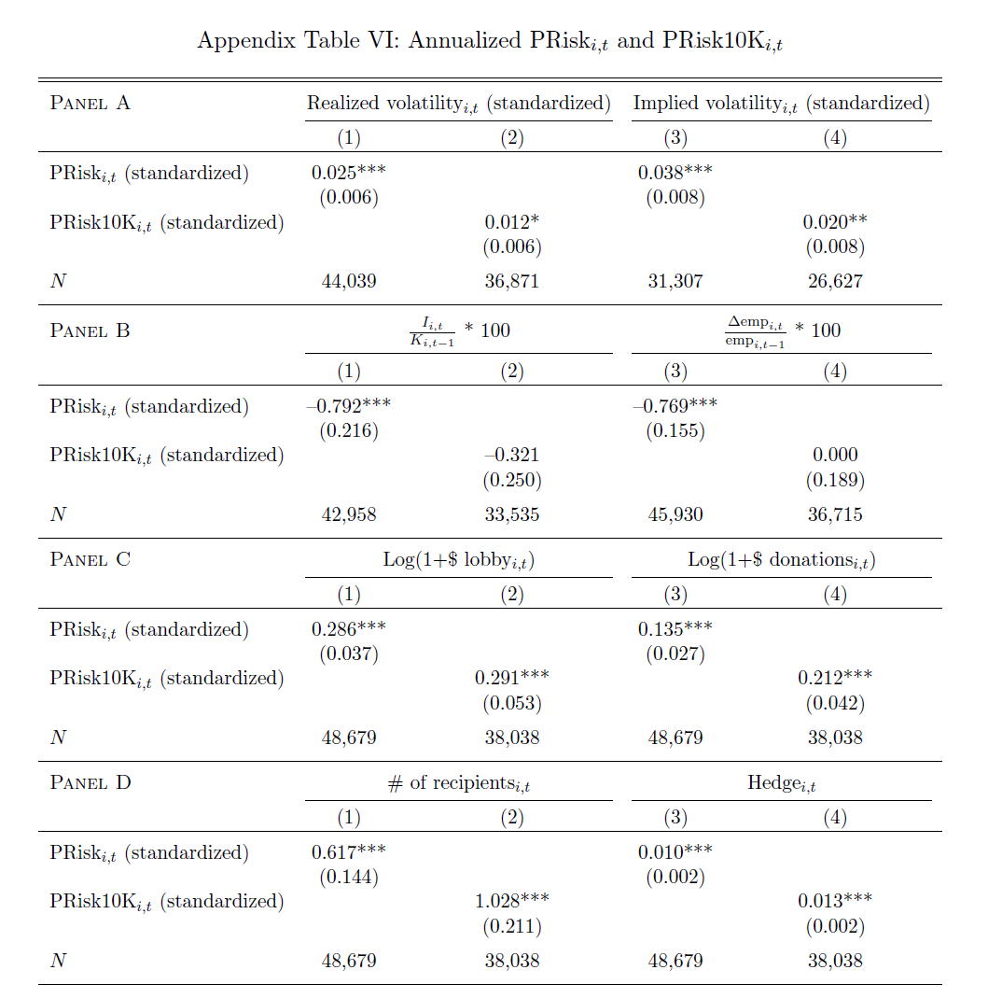
4. RESEARCH DESIGN AND RESULTS
Introduction
Main Findings
Sample and Variables
Res. Design and Results
Conclusion
Robustness Check (4): Use 10Ks instead of Conference Calls Transcripts
“This pattern may be due to the fact that disclosures in 10-Ks are highly scripted and tend to have higher disclosure thresholds than earnings conference calls”
Tarek A Hassan, Stephan Hollander, Laurence van Lent, Ahmed Tahoun. The Quarterly Journal of Economics: November 2019, Vol. 134, Issue 4, pp. 2135-2202.

Slide 57
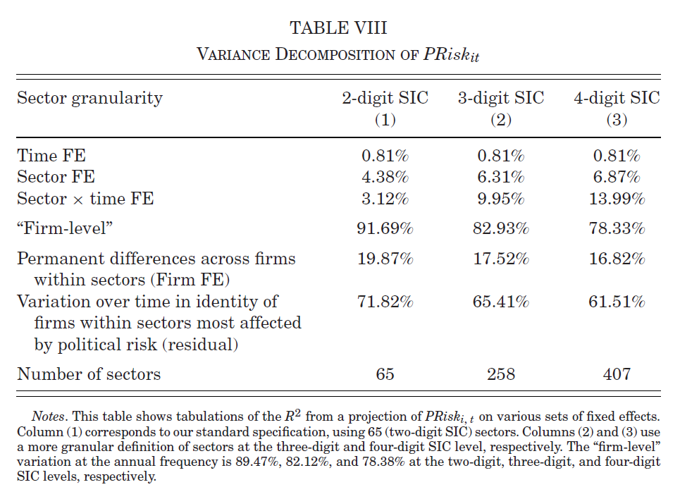
4. RESEARCH DESIGN AND RESULTS
Introduction
Main Findings
Sample and Variables
Res. Design and Results
Conclusion
Firm-level political risk: The incidence of political risk across firms is far more volatile and heterogeneous
Tarek A Hassan, Stephan Hollander, Laurence van Lent, Ahmed Tahoun. The Quarterly Journal of Economics: November 2019, Vol. 134, Issue 4, pp. 2135-2202.

Slide 58
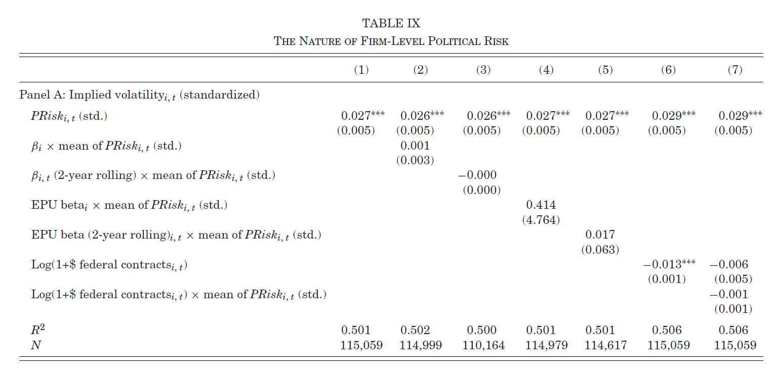
4. RESEARCH DESIGN AND RESULTS
Introduction
Main Findings
Sample and Variables
Res. Design and Results
Conclusion
Firm-level political risk: The incidence of political risk across firms is far more volatile and heterogeneous
Measures of exposure to aggregate political risks
Tarek A Hassan, Stephan Hollander, Laurence van Lent, Ahmed Tahoun. The Quarterly Journal of Economics: November 2019, Vol. 134, Issue 4, pp. 2135-2202.

Slide 59
4. RESEARCH DESIGN AND RESULTS
Introduction
Main Findings
Sample and Variables
Res. Design and Results
Conclusion
Firm-level political risk: The incidence of political risk across firms is far more volatile and heterogeneous
Measures of exposure to aggregate political risks
Tarek A Hassan, Stephan Hollander, Laurence van Lent, Ahmed Tahoun. The Quarterly Journal of Economics: November 2019, Vol. 134, Issue 4, pp. 2135-2202.

Slide 60
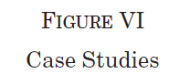


4. RESEARCH DESIGN AND RESULTS
Introduction
Main Findings
Sample and Variables
Res. Design and Results
Conclusion
Firm-level political risk: The incidence of political risk across firms is far more volatile and heterogeneous
Tarek A Hassan, Stephan Hollander, Laurence van Lent, Ahmed Tahoun. The Quarterly Journal of Economics: November 2019, Vol. 134, Issue 4, pp. 2135-2202.

Slide 61



4. RESEARCH DESIGN AND RESULTS
Introduction
Main Findings
Sample and Variables
Res. Design and Results
Conclusion
Timeline of Research Design
Main Variables
Measure topic-specific political risk
(6)
: the number of libraries in Z that contain bigram b
cf. inverse document frequency
8 Topics (Z=8):
① Economic Policy and Budget, ② Environment, ③ Trade, ④ Institutions and Political Process, ⑤ Health, ⑥ Security and Defense, ⑦ Tax Policy, ⑧ Technology and Infrastructure
Sources are from OnTheIssues.org, which educates voters about the positions politicians take on key topics
Other processes are equal to the abovementioned methods
Tarek A Hassan, Stephan Hollander, Laurence van Lent, Ahmed Tahoun. The Quarterly Journal of Economics: November 2019, Vol. 134, Issue 4, pp. 2135-2202.

Slide 62



4. RESEARCH DESIGN AND RESULTS
Introduction
Main Findings
Sample and Variables
Res. Design and Results
Conclusion
Timeline of Research Design
Main Variables
Measure topic-specific political risk
Tarek A Hassan, Stephan Hollander, Laurence van Lent, Ahmed Tahoun. The Quarterly Journal of Economics: November 2019, Vol. 134, Issue 4, pp. 2135-2202.

Slide 63

4. RESEARCH DESIGN AND RESULTS
Introduction
Main Findings
Sample and Variables
Res. Design and Results
Conclusion
Timeline of Research Design
Main Variables
Measure topic-specific political risk
80 topics
→ 8 topics
Tarek A Hassan, Stephan Hollander, Laurence van Lent, Ahmed Tahoun. The Quarterly Journal of Economics: November 2019, Vol. 134, Issue 4, pp. 2135-2202.

Slide 64

4. RESEARCH DESIGN AND RESULTS
Introduction
Main Findings
Sample and Variables
Res. Design and Results
Conclusion
Timeline of Research Design
Main Variables
Measure topic-specific political risk
(7)
The within firm-and-topic variation of our topic-based measure has economic content, finding that firms actively manage political risk by lobbying on the political topics they are most concerned about.
Tarek A Hassan, Stephan Hollander, Laurence van Lent, Ahmed Tahoun. The Quarterly Journal of Economics: November 2019, Vol. 134, Issue 4, pp. 2135-2202.

Slide 65
5. Conclusion

Slide 66
5. CONCLUSION
Introduction
Main Findings
Sample and Variables
Res. Design and Results
Conclusion
Conclusion
The authors adapt a simple pattern-based sequence classification method to construct a new measure of political risk faced by individual firms
The results corroborate that the measure indeed reflects meaningful firm-level variation in exposure to political risk
The authors find that a surprisingly large share of the variation in political risk appears to play out at the firm level, rather than the level of the sector or the economy as a whole
The economic impact of political risk is not well described by conventional models in which individual firms have relatively stable exposures to aggregate political risk
The main conclusion is that the effectiveness of political decision-making may affect the economy, not only by affecting aggregate political risk but also by creating idiosyncratic political risk
The authors generate additional measures of overall risk, nonpolitical risk, corresponding measures of political and nonpolitical sentiment, as well as additional measures of political risks associated with eight specific political topics
Tarek A Hassan, Stephan Hollander, Laurence van Lent, Ahmed Tahoun. The Quarterly Journal of Economics: November 2019, Vol. 134, Issue 4, pp. 2135-2202.

Slide 67
End of Document

